Slide 1
AZ-100.1 Module 03: Monitoring and Diagnostics

Slide 2
Lesson 01: Exploring Monitoring Capabilities in Azure

Slide 3
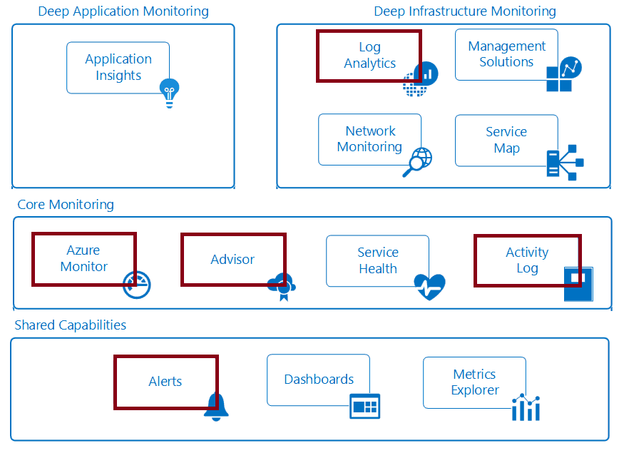
Introducing Azure Monitor Service
Notes:
✔ In this course we will cover the services that will help you with materials in the other courses. Specifically, the highlighted items in the diagram are covered in this course.
For more information, you can see:
Monitoring Azure applications and resources - https://docs.microsoft.com/en-us/azure/monitoring-and-diagnostics/monitoring-overview

Slide 4
Video: An Overview of Azure Monitor

Slide 5
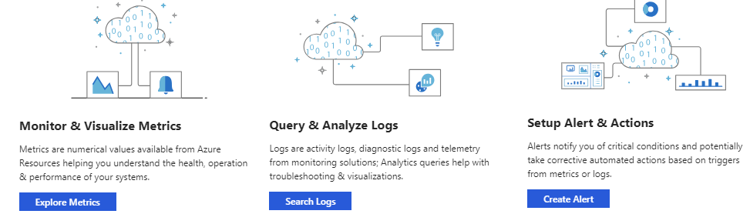
Azure Monitor: Key Capabilities
Core monitoring for Azure services
Collects metrics, activity logs, and diagnostic logs
Use for time critical alerts and notifications
Notes:
For more information, see:
Get started with Azure Monitor – https://docs.microsoft.com/en-us/azure/monitoring-and-diagnostics/monitoring-get-started

Slide 6
Video: Centralized Monitoring with Azure Monitor
Notes:
✔ You can think of Azure Monitor as a platform service which provides a pipeline for metric and log data coming from any Azure resource providers. Alerts and Activity Log are covered in more details in separate lessons. Log Analytics is covered in a separate module.

Slide 7
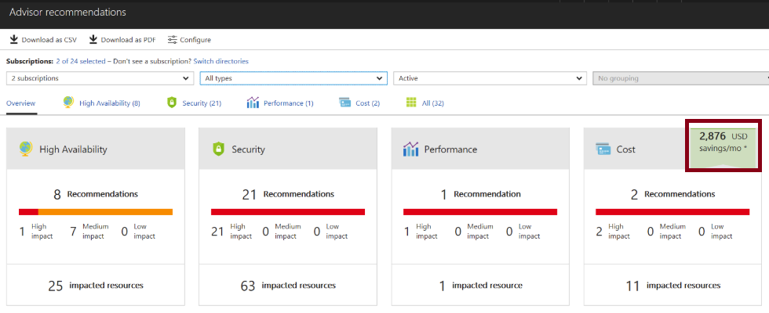
Azure Advisor
Personalized cloud consultant
Analyzes your configuration and recommends solutions
Four areas: High Availability, Security, Performance, and Cost
Notes:
✔ Advisor provides recommendations for virtual machines, availability sets, application gateways, App Services, SQL servers, and Redis Cache.
For more information, you can see:
Introduction to Azure Advisor - https://docs.microsoft.com/en-us/azure/advisor/advisor-overview
Advisor Cost recommendations - https://docs.microsoft.com/en-us/azure/advisor/advisor-cost-recommendations

Slide 8
Lesson 02: Azure Alerts

Slide 9
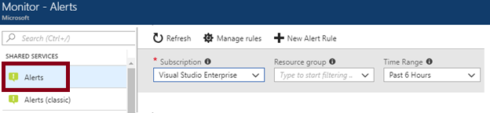
Azure Monitor Alerts
A unified authoring experience
Better creation workflow and fired alert notification
Consolidation into one view
Notes:
For more information, you can see:
The new alerts experience in Azure Monitor - https://docs.microsoft.com/en-us/azure/monitoring-and-diagnostics/monitoring-overview-unified-alerts

Slide 10
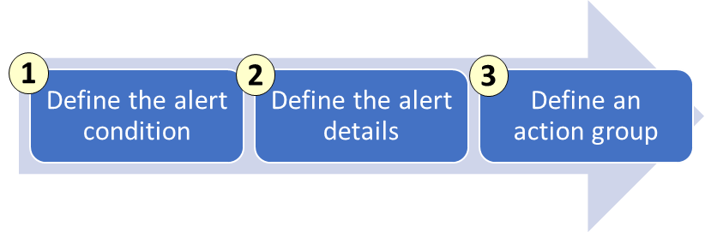
Creating Alert Rules
Define the alert condition with target, criteria, and logic
Define the alert details like rule name, description, and severity
Define the action group for notifications
Notes:
✔ Take a few minutes to create an alert rule and look at the options. Action groups are on the next slide.
For more information, you can see:
The new alerts experience in Azure Monitor - https://docs.microsoft.com/en-us/azure/monitoring-and-diagnostics/monitoring-overview-unified-alerts

Slide 11
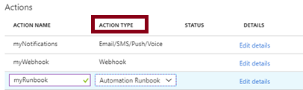
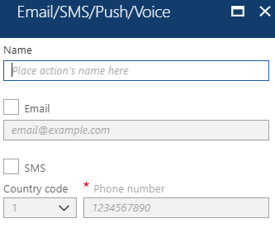
Action Groups
Configure a list of actions to take when the alert is triggered
Ensures the same actions are taken each time an alert is triggered
Action types: Email/SMS/Push/Voice, Logic App, Webhook, IT Service Management, or Automation Runbook
Notes:
✔ Take a few minutes to create an action group using the link below.
For more information, you can see:
Create an action group by using the Azure portal - https://docs.microsoft.com/en-us/azure/monitoring-and-diagnostics/monitoring-action-groups#create-an-action-group-by-using-the-azure-portal
Action specific information - https://docs.microsoft.com/en-us/azure/monitoring-and-diagnostics/monitoring-action-groups#action-specific-information
Rate limiting for Voice, SMS, emails, Azure App push notifications and webhook posts - https://docs.microsoft.com/en-us/azure/monitoring-and-diagnostics/monitoring-alerts-rate-limiting

Slide 12
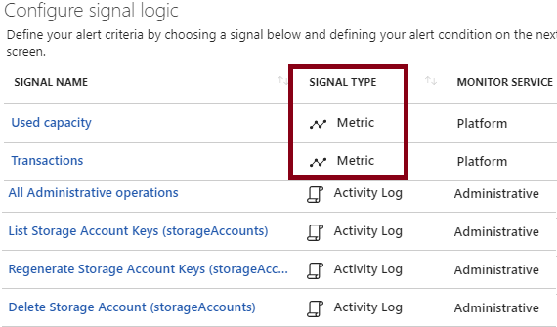
Signal Types and Metrics
Improved latency
Support for multi-dimensional metrics
More control over metric conditions
Combined monitoring of multiple metrics
Metrics from Logs
Notes:
For more information, you can see:
Alert rule terminology - https://docs.microsoft.com/en-us/azure/monitoring-and-diagnostics/monitoring-overview-unified-alerts#alert-rules-terminology

Slide 13
Additional Practice: Alerts
Audit and receive notifications about important actions in your Azure subscription
Create a network security group
Browse the Activity Log in the portal
Browse an event in the Activity log
Create an Activity log alert
Test the Activity log alert
Notes:
✔ Can you see how the activity log lets you monitor activity at the subscription level? If you like, try another practice using the reference link.
For more information, you can see:
Create, view, and manage alerts using Azure Monitor - https://docs.microsoft.com/en-us/azure/monitoring-and-diagnostics/monitor-alerts-unified-usage

Slide 14
Lesson 03: Azure Activity Log

Slide 15
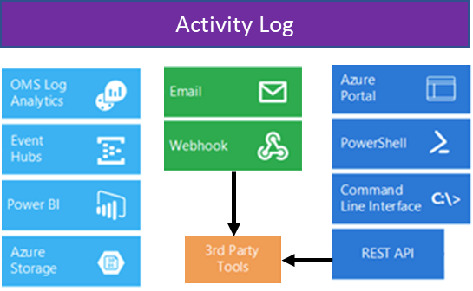
Overview of Activity Log
Send data to Log Analytics for advanced search and alerts
Query or manage events in the Portal, PowerShell, CLI, and REST API
Stream information to Event Hub
Archive data to a storage account
Analyze data with Power BI
Notes:
✔ The Activity Log differs from Diagnostic Logs (https://docs.microsoft.com/en-us/azure/monitoring-and-diagnostics/monitoring-overview-of-diagnostic-logs). Activity Logs provide data about the operations on a resource from the outside (the "control plane"). Diagnostics Logs are emitted by a resource and provide information about the operation of that resource (the "data plane").
For more information, you can see:
Monitor Subscription Activity with the Azure Activity Log - https://docs.microsoft.com/en-us/azure/monitoring-and-diagnostics/monitoring-overview-activity-logs

Slide 16
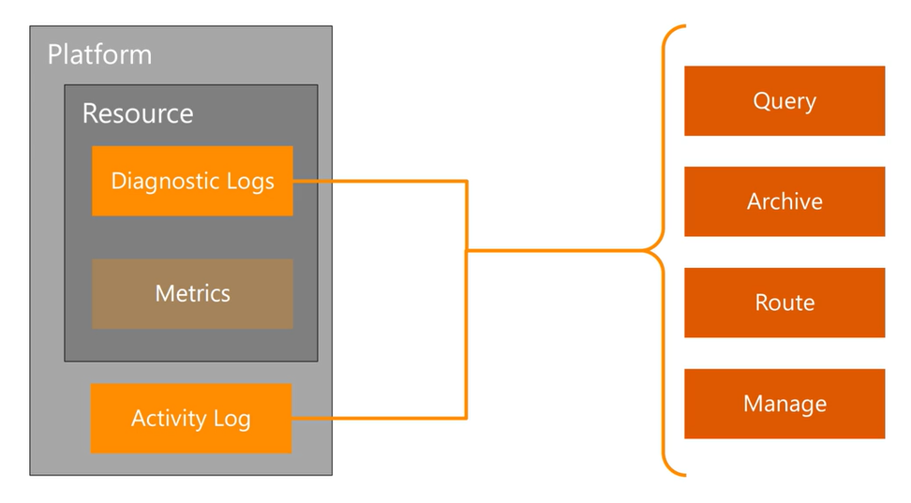
Video: Activity Log
Notes:
✔ You can think of Azure Monitor as a platform service which provides a pipeline for metric and log data coming from any Azure resource providers. Alerts and Activity Log are covered in more details in separate lessons. Log Analytics is covered in a separate module.

Slide 17
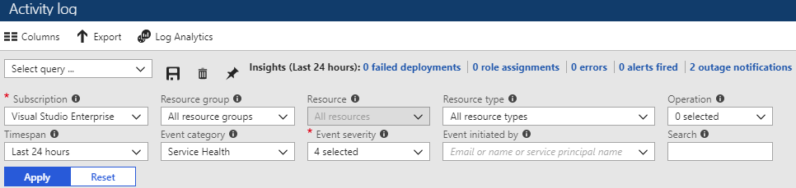
Query the Activity Log
Filter by: Subscription, Resource group, Resource (name), Resource type, Operation name, Timespan, Category, Severity, and Event initiated by
Notes:
✔ Once you have defined a set of filters, you can save it as a query that is persisted across sessions if you ever need to perform the same query with those filters applied again in the future. You can also pin a query to your Azure dashboard to always keep an eye on specific events.
For more information, you can see:
Query the Activity Log in the Azure portal - https://docs.microsoft.com/en-us/azure/monitoring-and-diagnostics/monitoring-overview-activity-logs#query-the-activity-log-in-the-azure-portal

Slide 18
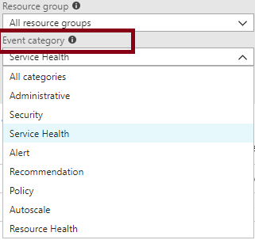
Event Categories
Administrative events
Service health events with status
Alert events
Autoscale events
Usage recommendations
Security events
Policy and Resource Health (reserved)
Notes:
For more information, you can see:
Categories in the Activity Log - https://docs.microsoft.com/en-us/azure/monitoring-and-diagnostics/monitoring-overview-activity-logs#categories-in-the-activity-log

Slide 19
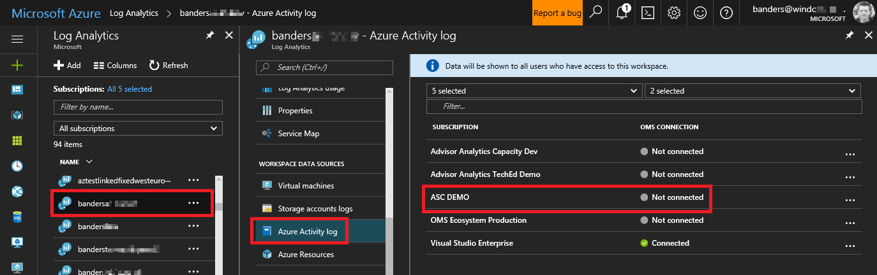
Activity Log and Log Analytics
Analyze the activity logs with pre-defined views
Analyze and search activity logs from multiple Azure subscriptions
See operational activities aggregated by status
View trends of activities happening on each of your Azure services
Notes:
✔ Log Analytics collects activity logs and stores the logs for 90 days free of charge. If you store logs for longer than 90 days, you will incur data retention charges for the data stored longer than that period. When you're on the Free pricing tier, activity logs do not apply to your daily data consumption. The next module is Log Analytics.
For more information, you can see:
Collect and analyze Azure activity logs in Log Analytics - https://docs.microsoft.com/en-us/azure/log-analytics/log-analytics-activity

Slide 20
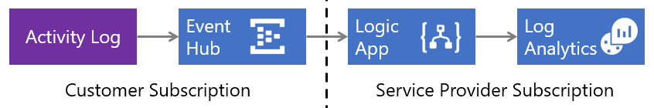
Collect Across Subscriptions
Low latency and minimal coding
Azure Activity Log sends events to an Event Hub where a Logic App sends them to your Log Analytics workspace
Notes:
✔ Do you think your organization would benefit from this strategy?
For more information, you can see:
Collect Azure Activity Logs into Log Analytics across subscriptions - https://docs.microsoft.com/en-us/azure/log-analytics/log-analytics-activity-logs-subscriptions

Slide 21
Video: Activity Log Alerts
Notes:
✔ You can think of Azure Monitor as a platform service which provides a pipeline for metric and log data coming from any Azure resource providers. Alerts and Activity Log are covered in more details in separate lessons. Log Analytics is covered in a separate module.

Slide 22
Additional Practice: Activity Log
Configure activity logs in the Azure portal
Create an activity log alert
View the Activity Log in the Azure portal
Configure log profiles using the Azure portal
Enable streaming of the Activity Log
Archive the Activity Log using the portal
Configure the Activity Log Analytics solution for your workspaces
Notes:
✔️ The tasks listed are only a representative sampling of what you can do with Activity Logs. Explore some of the other tasks as you have time. Don’t forget to view the associated Activity Log dashboards. (Click the Azure Activity Logs tile to open the Azure Activity Logs dashboard.) Try some PowerShell and CLI tasks.
For more information, see:
Create activity log alerts – https://docs.microsoft.com/en-us/azure/monitoring-and-diagnostics/monitoring-activity-log-alerts
Stream the Azure Activity Log to Event Hubs – https://docs.microsoft.com/en-us/azure/monitoring-and-diagnostics/monitoring-stream-activity-logs-event-hubs
Archive the Azure Activity Log – https://docs.microsoft.com/en-us/azure/monitoring-and-diagnostics/monitoring-archive-activity-log
Collect and analyze Azure activity logs in Log Analytics - https://docs.microsoft.com/en-us/azure/log-analytics/log-analytics-activity

Slide 23
Module 3: Review Questions
Your organization has a hybrid Azure infrastructure, with several business-critical resources in Azure as well as on-premises. You need to ensure that you receive a notification when any of the systems are unavailable or experience latency. You decide to use Alerting in Azure Monitor. What metric alerts types are available?
Your organization is a Managed Service Provider that manages Azure subscription for several clients. You need to monitor your client’s Azure environments. You decide to use Log Analytics. How should it be used, and what are the benefits for your clients?
You manage security for an organization. A business-critical system has been shut down. Management suspects that an employee is responsible. You need to audit the environment and find the user responsible. Which tool should you use and why?
Notes:
Q1 Answer: Alerting is now available with Azure Monitor. Signals are emitted by the Target resource and can be of several types including Metric, Activity log, Application Insights, and Log types. Newer metric alerts specifically have the following improvements:
Improved latency: Newer metric alerts can run as often as every minute. Log alerts still have a longer than 1-minute delay due to the time is takes to ingest the logs.
Support for multi-dimensional metrics: You can alert on dimensional metrics allowing you to monitor an interesting segment of the metric.
More control over metric conditions: You can define richer alert rules. The newer alerts support monitoring the maximum, minimum, average, and total values of metrics.
Combined monitoring of multiple metrics: You can monitor multiple metrics (currently, up to two metrics) with a single rule. An alert is triggered if both metrics breach their respective thresholds for the specified time-period.
Metrics from Logs (limited public preview): Some log data going into Log Analytics can now be extracted and converted into Azure Monitor metrics and then alerted on just like other metrics.
Q2 Answer: Collect Azure Activity Logs into a Log Analytics workspace using the Azure Log Analytics Data Collector connector for Logic Apps. Use this strategy when you need to send logs to a workspace in a different Azure Active Directory. For example, if you are a managed service provider, you may want to collect activity logs from a customer's subscription and store them in a Log Analytics workspace in your own subscription.
The basic strategy is to have Azure Activity Log send events to an Event Hub where a Logic App sends them to your Log Analytics workspace. The benefits for the clients are:
Analysis of resource configuration.
Usage telemetry.
Solution recommendations that can help you improve cost effectiveness, performance, high availability, and security.
Q3 Answer: The Azure Activity Log is a subscription log that gives insight into subscription-level events that have occurred in Azure. This includes a range of data, from Azure Resource Manager operational data to updates on Service Health events. The Activity Log was previously known as “Audit Logs” or “Operational Logs”.
Using the Activity Log, you can determine the “what, who, and when” for any write operation taken on the resources in your subscription. It gives an audit trail of the activities or operations performed on your resources by someone working on the Azure platform. You can also understand the status of the operation and other relevant properties.

